Slide 1
OOP
Principles of OOP: Abstraction, Encapsulation, Cohesion, Coupling, Refactoring
Based on Barnes and Kolling Chapter 6
Notes:
SDJ Lecture 5: Objects Intro pt2
© Swinburne or © Pearson Education, IncA Bayley
A Bayley

Slide 2
Learning outcome
Students can understand the principles of achieving a good OO design
  Abstraction, Modularization
  Encapsulation
  Cohesion
  Coupling
  Responsibility driven design
  Refactoring

Slide 3

Good Object-Oriented Design
Abstraction
Modularization
Encapsulation
are all aspects of “data hiding”

Slide 4
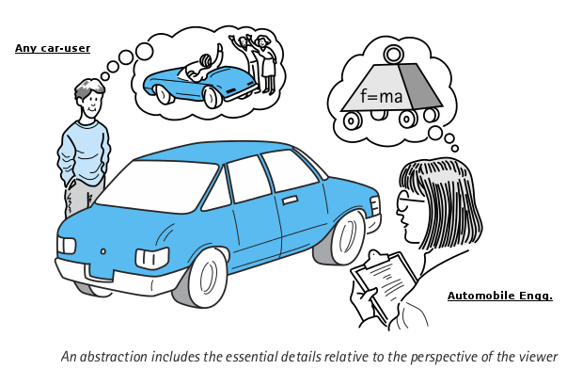
Abstraction
Abstraction is the ability to ignore details of parts to focus attention on a higher level of a problem.
It means “show only the details which matter to the user”
I am not concerned of how the car works according to physics
I want a car

Slide 5

Modularization
Modularization is the process of dividing a whole into well-defined parts, which interact in well-defined ways
  So can be built and examined separately.
  Divide and conquer
  We created separate methods to address separate problems
Break the problem up into smaller parts
Notes:
SDJ Lecture 6 : Object Collaboration
© Swinburne, © Pearson Education, Inc

Slide 6
Encapsulation
Encapsulation means preventing other code exploiting implementation details
Don’t make fields public
In software programs,
  No need to know how the class is implemented
  Need to know which public method to invoke to get the job done
  Thus, implementation details can change any time without effecting other parts of the program
Provide ‘get’ and ‘set’ methods when a field needs to be inspected or changed
  Usually we need a few accessors
  mutators other than 'set' usually do the real work
Notes:
SDJ Lecture 5: Objects Intro pt2
© Swinburne or © Pearson Education, IncA Bayley

Slide 7
Software changes
Software is not like a novel that is written once and then remains unchanged.
Software is extended, corrected, maintained, ported, adapted, …
The work is done by different people over time (often decades).
Objects First with Java - A Practical Introduction using BlueJ, © David J. Barnes, Michael Kölling

Slide 8
Change or die
There are only two options for software:
  Either it is continuously maintained
  or it dies.
Software that cannot be maintained will be thrown away.
Objects First with Java - A Practical Introduction using BlueJ, © David J. Barnes, Michael Kölling

Slide 9
Code and design quality
If we are to be critical of code quality, we need evaluation criteria.
Two important concepts for assessing the quality of code are:
  Coupling
  Cohesion
Objects First with Java - A Practical Introduction using BlueJ, © David J. Barnes, Michael Kölling

Slide 10
Coupling
Coupling refers to links between separate units of a program.
If two classes depend closely on many details of each other, we say they are tightly coupled.
We aim for loose coupling.
A class diagram provides (limited) hints at the degree of coupling.
Objects First with Java - A Practical Introduction using BlueJ, © David J. Barnes, Michael Kölling

Slide 11
Tight coupling
We try to avoid tight coupling.
Changes to one class bring a cascade of changes to other classes.
Classes are harder to understand in isolation.
Flow of control between objects of different classes is complex.
Objects First with Java - A Practical Introduction using BlueJ, © David J. Barnes, Michael Kölling

Slide 12
Loose coupling
We aim for loose coupling.
Loose coupling makes it possible to:
  understand one class without reading others;
  change one class with little or no effect on other classes.
Thus: loose coupling increases maintainability.
Objects First with Java - A Practical Introduction using BlueJ, © David J. Barnes, Michael Kölling

Slide 13
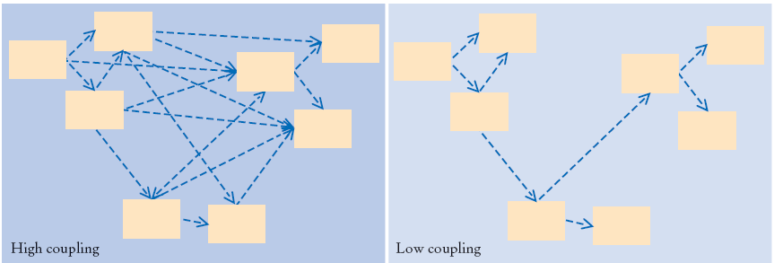
Coupling
Describes the inter-connectedness of classes
We should strive for "loose" or "low" coupling:
A system where each class is
  largely independent
  communicates with other classes via a small, well-defined interface
So that we can change a class without having to make several changes in other classes that are affected by the change.

Slide 14
Coupling
Encapsulation influences the degree of coupling
  With encapsulation we always keep our fields private and provide a public accessor method to access them from other classes
  If no other class knows how our information is stored, then we can easily change how it is stored without breaking other classes.
Responsibility driven design also influences coupling

Slide 15
Cohesion
Cohesion refers to the number and diversity of tasks that a single unit is responsible for.
If each unit is responsible for one single logical task, we say it has high cohesion.
We aim for high cohesion.
‘Unit’ applies to classes, methods and modules (packages).
Objects First with Java - A Practical Introduction using BlueJ, © David J. Barnes, Michael Kölling

Slide 16
High cohesion
We aim for high cohesion.
High cohesion makes it easier to:
  understand what a class or method does;
  use descriptive names for variables, methods and classes;
  reuse classes and methods.
Objects First with Java - A Practical Introduction using BlueJ, © David J. Barnes, Michael Kölling

Slide 17
Loose cohesion
We aim to avoid loosely cohesive classes and methods.
Methods perform multiple tasks.
Classes have no clear identity.
Objects First with Java - A Practical Introduction using BlueJ, © David J. Barnes, Michael Kölling

Slide 18
Cohesion
How well a unit of code maps to a logical task or entity
Each method should be responsible for one well-defined task or one logical operation
Each class should be responsible for one well-defined entity
Good class design exhibits a high degree of cohesion.
Cohesion promotes reusability
Public class Calculator
{
public void print(){…}
public void depositCash(){…}
public double getAverage(int a, int b){…}
}
X
Poor cohesion in class Calculator!!!

Slide 19
Cohesion applied at different levels
Class level:
  Classes should represent one single, well defined entity.
Method level:
  A method should be responsible for one and only one well defined task.
Objects First with Java - A Practical Introduction using BlueJ, © David J. Barnes, Michael Kölling

Slide 20
Code duplication
Code duplication
  is an indicator of bad design,
  makes maintenance harder,
  can lead to introduction of errors during maintenance.
Objects First with Java - A Practical Introduction using BlueJ, © David J. Barnes, Michael Kölling

Slide 21
Responsibility-driven design
It means each class should be responsible to handle it’s own data
When adding new functionality to an application, always ask in which class we should add a method to implement this new function.
  Which class should be responsible for implementing task X?
    The answer is that the class that is responsible for storing the data should also be responsible for manipulating it.
Where should we implement validatePayment() ????
Reservation
-resId
-resDate
-duration
Payment
-amount
Notes:
SDJ Lecture 5: Objects Intro pt2
© Swinburne or © Pearson Education, IncA Bayley

Slide 22
Responsibility-driven design
Question: where should we add a new method (which class)?
Each class should be responsible for manipulating its own data.
The class that owns the data should be responsible for processing it.
RDD leads to low coupling.
Objects First with Java - A Practical Introduction using BlueJ, © David J. Barnes, Michael Kölling

Slide 23
Localizing change
One aim of reducing coupling and responsibility-driven design is to localize change.
When a change is needed, as few classes as possible should be affected.
Objects First with Java - A Practical Introduction using BlueJ, © David J. Barnes, Michael Kölling

Slide 24
Thinking ahead
When designing a class, we try to think what changes are likely to be made in the future.
We aim to make those changes easy.
Objects First with Java - A Practical Introduction using BlueJ, © David J. Barnes, Michael Kölling

Slide 25
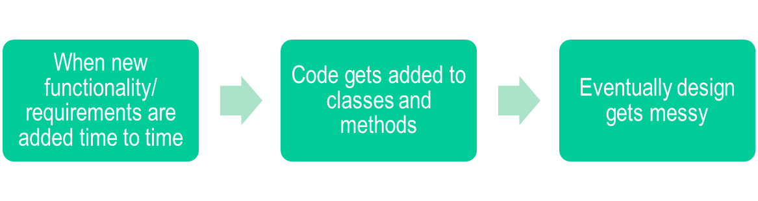
Refactoring
Refactoring is the activity of restructuring an existing design (classes and methods) when the application is modified or extended
  Goal: maintain good class design
Notes:
When designing applications, we should attempt to think ahead, anticipate possible changes in the future, and create highly cohesive, loosely coupled classes and methods that make modifications easy. This is a noble goal, but of course we cannot always anticipate all future adaptations, and it is not feasible to prepare for all possible extensions we can think of.
After refactoring classes gets split to two or more classes and methods will get split further.
SDJ Lecture 5: Objects Intro pt2
© Swinburne or © Pearson Education, IncA Bayley

Slide 26
Refactoring
Steps:
  Create and record tests including expected output with the current design/ implementation.
  Change the classes (refactor the internal structure)
  Test to assure that the system still produces the same output for the same tests (that were run on the system before modification)
  Make the further enhancements on the refactored version.
  Repeat until all changes are done
Notes:
SDJ Lecture 5: Objects Intro pt2
© Swinburne or © Pearson Education, IncA Bayley

Slide 27
Design questions
Common questions:
  How long should a class be?
  How long should a method be?
These can now be answered in terms of cohesion and coupling.
Objects First with Java - A Practical Introduction using BlueJ, © David J. Barnes, Michael Kölling

Slide 28
Design guidelines
A method is too long if it does more then one logical task.
A class is too complex if it represents more than one logical entity.
Note: these are guidelines - they still leave much open to the designer.
Objects First with Java - A Practical Introduction using BlueJ, © David J. Barnes, Michael Kölling

Slide 29
Refernces
Read Barnes & Kolling Chapter 6
More on cohesion and coupling:_x000b_http://www.cs.toronto.edu/~sme/CSC444F/slides/L12-SoftwareQuality.pdf

Slide 30

Exercises
Try to do exercises from Barnes & Kolling Chapter 6 "Designing Classes"
Notes:
SDJ Lecture 5: Objects Intro pt2
© Swinburne or © Pearson Education, IncA Bayley

